Slide 1
Digital Portfolio
STUDENT NAME: AMALKRISNHNA.K
REGISTER NO AND NMID: asbruce2428c0542
DEPARTMENT: BSC AI&ML
COLLEGE: JCT College of Arts And Science

Slide 2
PROJECT TITLE DIGITAL PORTFOLIO

Slide 3


AGENDA
Problem Statement
Project Overview
End Users
Tools and Technologies
Portfolio design and Layout
Features and Functionality
Results and Screenshots
Conclusion
Github Link
3/21/2024 Annual Review

Slide 4

PROBLEM STATEMENT
AMALKRISHNA.K aims to develop a user-friendly online registration system for students to easily enroll in courses. Currently, the manual registration process is time-consuming, prone to errors, and inefficient. The goal is AMALKRISHNA.Kaims to develop a user-friendly online registration system for students to easily enroll in courses. Currently, the manual registration process is time-consuming, prone to errors, and inefficient. The goal is to create a digital platform that simplifies the registration process, reduces paperwork, and improves data management. to create a digital platform that simplifies the registration process, reduces paperwork, and improves data management.

Slide 5

PROJECT OVERVIEW
This project, led by AMALKRISHNA.K, focuses on developing an Online Student Registration System designed to streamline the enrollment process for educational institutions. The system will provide an intuitive web interface where students can register for courses, submit necessary details, and receive confirmation instantly. By automating the registration process, the project aims to reduce administrative workload, minimize errors, and provide a better user experience for both students and staff.
The system will include features such as user authentication, form validation, course selection, and database management to store student information securely. The project will be developed using HTML, CSS, and backend technologies (to be decided) and is targeted for deployment in a school or college environment.

Slide 6

WHO ARE THE END USERS?
The primary end users of the Online Student Registration System developed by AMALKRISHNA.K include:
Students: They will use the system to browse available courses, register online, update their personal details, and receive registration confirmation.
Academic Staff: Teachers and course coordinators can access the system to manage course offerings, monitor student registrations, and communicate important updates.
Administrative Staff: They will handle the backend management, oversee the registration process, generate reports, and maintain student records efficiently.
IT Support Team: Responsible for maintaining the system’s technical health, ensuring data security, and providing technical assistance to users.

Slide 7

TOOLS AND TECHNIQUES
The development of the Online Student Registration System by Muhammed Jaufar.M will utilize the following tools and technologies:
Frontend:
HTML5 – For structuring web pages
CSS3 – For styling and layout design
JavaScript – For interactive elements and client-side validation
Backend:
(Choose one based on your preference)
PHP or Node.js or Python (Django/Flask) – For server-side logic and database interaction
Database:
MySQL or PostgreSQL – To store student and course data securely
Development Tools:
Visual Studio Code – Code editor
Git – Version control system
Browser Developer Tools – For testing and debugging
Other Technologies:
Bootstrap (optional) – For responsive and mobile-friendly design
Ajax (optional) – For asynchronous form submissions and smoother user experience

Slide 8
POTFOLIO DESIGN AND LAYOUT
1. Header:
Your name prominently displayed at the top.
Navigation menu with links like About, Projects, and Contact.
Clean background color with readable font.
2. About Section:
A brief introduction about yourself.
Your skills, experience, or interests.
Possibly a small photo or avatar.
3. Projects Section:
A grid or list showing your projects.
Each project includes:
A thumbnail image or screenshot.
Project title.
Short description.
Projects should be easy to scan, clickable to see details if needed.
4. Contact Section:
Simple contact form with fields like Name, Email, and Message.
Alternatively, display your email address and social media links.
Clear call-to-action button for submitting messages.
5. Footer (optional):
Copyright notice.
Links to social media profiles or additional resources.
Design style:
Clean and minimalistic.
Use a consistent color scheme (e.g., 2-3 colors max).
Responsive layout to look good on desktop and mobile.
Use readable fonts and appropriate spacing.
8

Slide 9
FEATURES AND FUNCTIONALITY
1. Responsive Design
The portfolio adjusts smoothly to different screen sizes (desktop, tablet, mobile).
2. Navigation Menu
Easy-to-use menu to quickly jump between sections (About, Projects, Contact).
Sticky or fixed navigation for accessibility while scrolling (optional).
3. About Section
Personal introduction with a professional summary.
Display of skills, expertise, or a short bio.
4. Project Showcase
Grid or list displaying projects with images or screenshots.
Project titles and brief descriptions.
Clickable project cards for detailed views or links to live demos/code repositories.
5. Contact Form
Simple form with Name, Email, Message fields.
Form validation to ensure correct inputs.
Submission functionality (e.g., sending message via email or backend).
Confirmation message or feedback after form submission.
6. Visual Design & Interactivity
Smooth hover effects on buttons and project cards.
Transitions and animations for elements entering the viewport (optional).
Consistent color scheme and typography.
7. Social Media Integration
Links/icons to social profiles like LinkedIn, GitHub, Twitter, etc.
8. SEO Friendly
Proper HTML tags and meta descriptions for better search engine indexing.
9. Fast Loading Time
Optimized images and minimal external dependencies.
10. Accessibility
Keyboard navigable.
Screen-reader friendly labels and ARIA attributes.

Slide 10
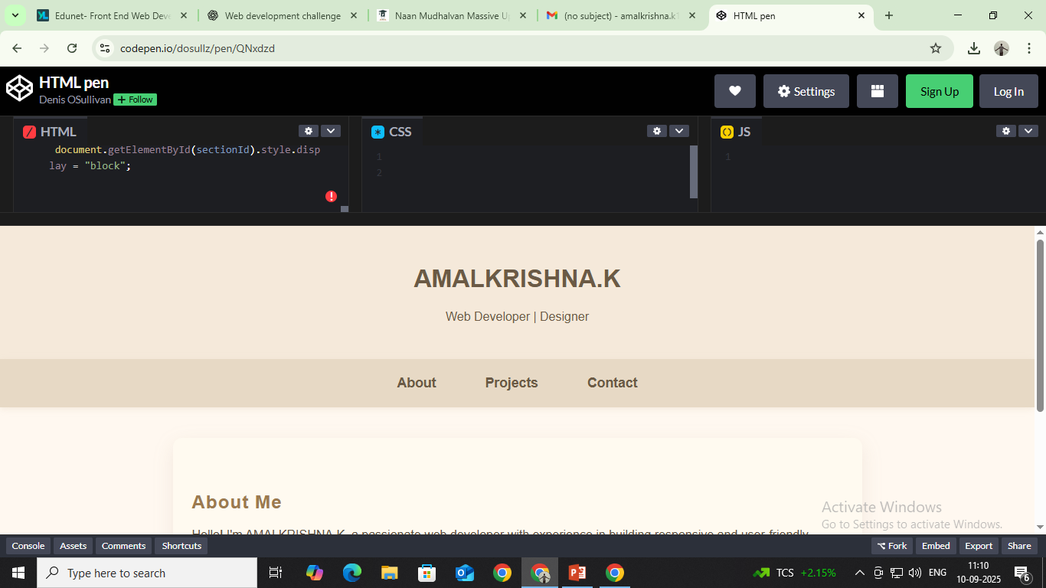

RESULTS AND SCREENSHOTS
3/21/2024 Annual Review
10

Slide 11
CONCLUSION
This portfolio website serves as a professional platform to showcase my skills, projects, and contact information effectively. It features a clean, responsive design that adapts well to different devices, ensuring a great user experience. The layout highlights key sections such as About Me, Projects, and Contact, making it easy for visitors to learn about my work and get in touch.
Overall, this portfolio not only reflects my technical abilities in web development but also demonstrates my attention to detail, design sense, and commitment to delivering user-friendly digital experiences. Moving forward, I plan to enhance it further with interactive elements and backend integration to make it even more dynamic and engaging.
11

Slide 12
CONCLUSION
https://github.com/amalkrishnak12-collab/NM.git
12

